Slide 1
Problem Statement
Vehicle Movement Analysis and Insight Generation in a College Campus using Edge AI

Slide 2
Unique Idea Brief (Solution)
The provided code offers a unique idea by implementing real-time vehicle detection and counting using edge AI. It uses background subtraction for motion detection, morphological operations for noise reduction, and contour detection for identifying vehicles. The innovation lies in its ability to dynamically track vehicle movements across a defined line, accurately counting each vehicle, which can be used for traffic flow analysis and congestion management in a college campus or similar environments.

Slide 3
Features Offered
- Real-time vehicle counting and tracking
- Background subtraction using MOG
- Grayscale conversion and Gaussian blur for noise reduction
- Morphological operations for enhancing detection
- Contour detection for identifying vehicles
- Bounding boxes and center point calculation
- Line crossing detection for vehicle counting
- Real-time count display on video frame

Slide 4
Process flow
1. Open video file.
2. Set parameters for detection.
3. Initialize background subtractor.
4. Calculate vehicle center points.
5. Initialize detection list and counter.
6. Capture and preprocess video frames.
7. Apply background subtraction and morphological operations.
8. Detect and validate contours.
9. Track and count vehicles crossing the line.
10. Display results.
11. Exit and cleanup.

Slide 5
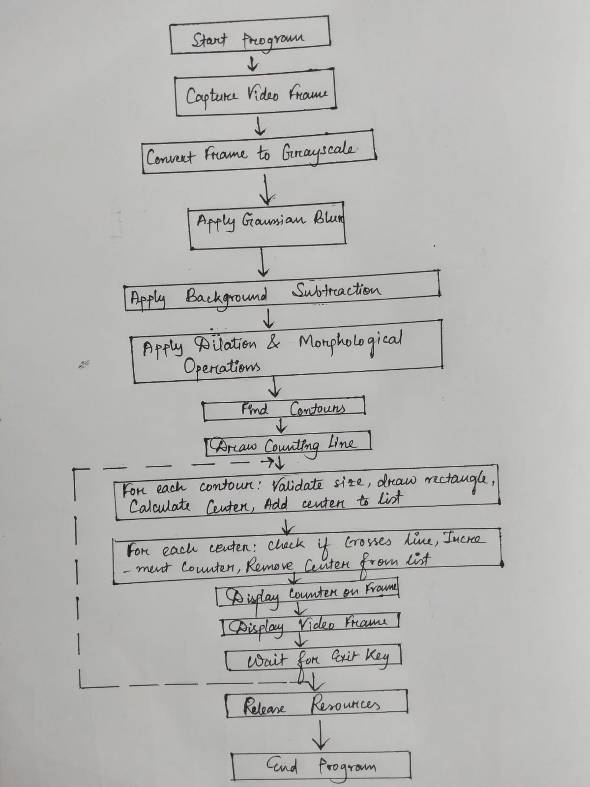
Architecture Diagram

Slide 6
Technologies used
OpenCV: For video capture, image processing, and computer vision tasks.
NumPy: For numerical operations and array manipulations.
Background Subtraction (MOG): To detect moving objects in video frames.
Contour Detection: To identify and track vehicles.
Gaussian Blur: For noise reduction in images.
Morphological Operations: To enhance image quality and object detection accuracy.

Slide 7
Team members and contribution:
Team Lead Name: Arpa Kundu
Developed and optimized background subtraction algorithms, Implemented the application logic based on the algorithm specifications, focusing on real-time visualization and user interface using OpenCV and Python libraries.
Team Member 2 Name: DEBNATH PATRA
Prepared comprehensive documentation on the project, including data sources, methodologies, and results.
Team Member 3 Name: BHAGYASHREE BAID
Set up and maintained the video capture and integrates sensor data, handles debugging, and ensures algorithmic efficiency.
Team Member 4 Name: ABHRAKANTI JANA
Created the presentation to showcase findings and recommendations and also have worked on documentation maintenance.

Slide 8
Conclusion
Vehicle Movement Analysis and Insight Generation projects are pivotal for optimizing traffic, enhancing safety, and advancing urban planning. By leveraging data-driven analytics and emerging technologies like AI and IoT, these projects not only improve operational efficiencies but also pave the way for sustainable and smart city initiatives. Embracing these trends ensures future mobility solutions are efficient, safe, and environmentally conscious.

